Slide 2
Go to http://riak.co/basic-lab
password: laboratory
Click in the editor window.
Type your name at the end of a URL in the list.

Slide 3
How do you get Riak?

Slide 4
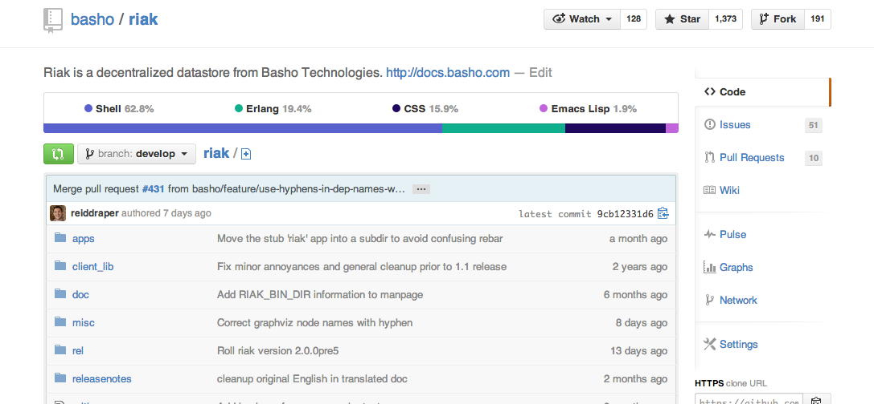
Github
basho/riak

Slide 5
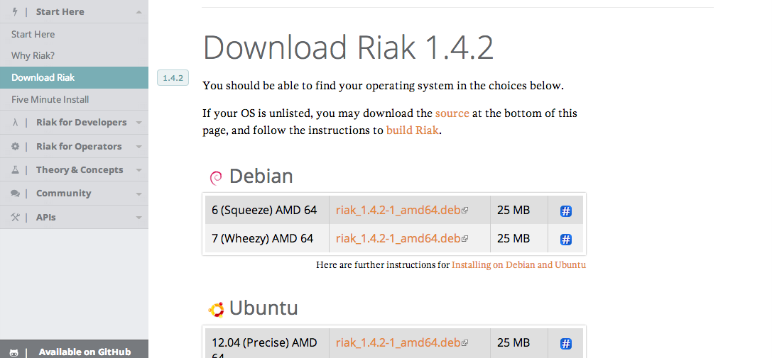
docs.basho.com
riak/latest/downloads

Slide 6
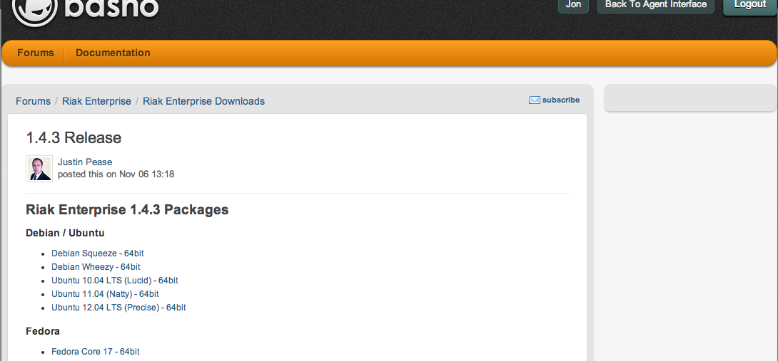
help.basho.com
For Enterprise Customers

Slide 7
What you get

Slide 8
Scripts

Slide 9
Configs

Slide 10
Logs

Slide 11
Libraries

Slide 12
Data

